Slide 1
Spatial Contiguity Principle
Alyssa Garcia

Slide 2
Agenda
Introduction to Spatial Contiguity
Applying the Principle
Supporting Research
Wrap-Up

Slide 3
1

Slide 4
Introduction
Spatial Contiguity Principle: Students learn better when corresponding words and pictures are presented near rather than far from each other on the page or screen.
When presenting information through multimedia formats, space is limited.²

Slide 5
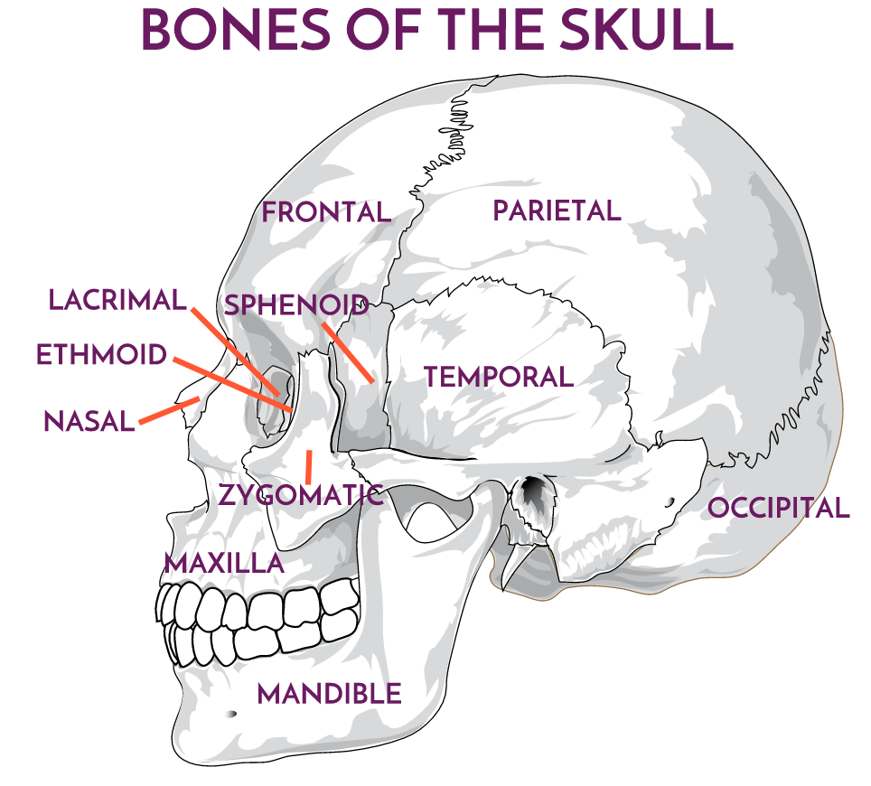
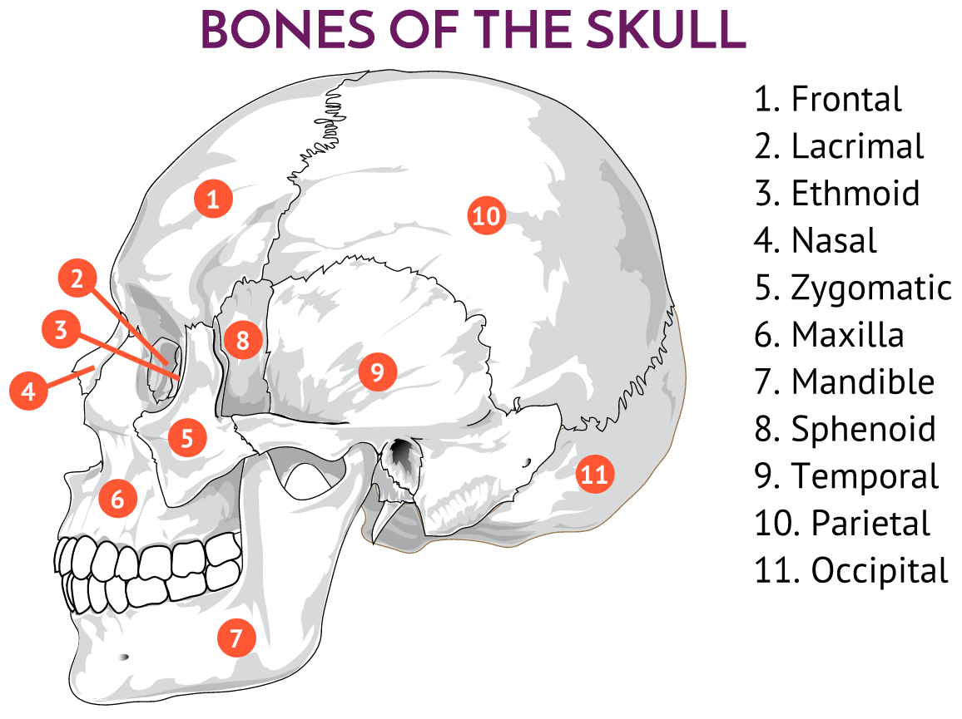
Applying the Principle- Part 1
Reduce cognitive load by making it easy for your audience to know where to look.³
Example:
vs

Slide 6
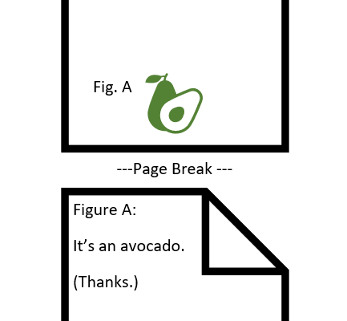
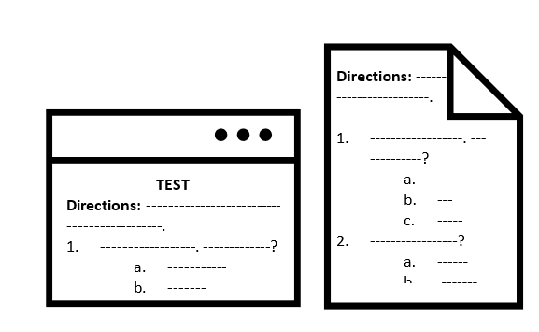
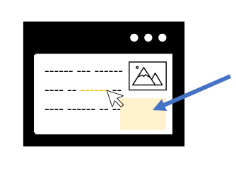
Applying the Principle- Part 2
Scrolling Screens
Directions
Primary Lesson Screen
Take care to keep a graphic and it’s supporting text on the same screen
Ex.
Directions for an activity or test should be in proximity
This makes it easier for the learner to clarify information while completing the task
Avoid linking to a separate window when possible; it causes a break in mental processing
Mouse-over boxes are a good alternative⁴

Slide 7
Question for the Class:
Has this principle ever presented a challenge for you as a learner, ID, or instructor?

Slide 8
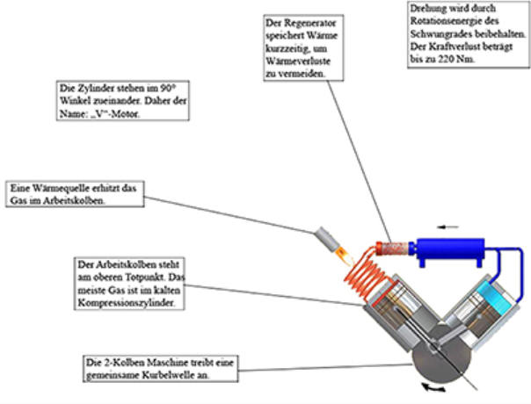
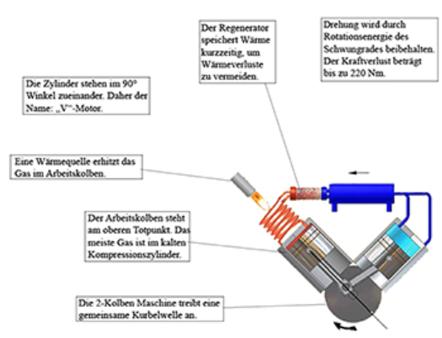
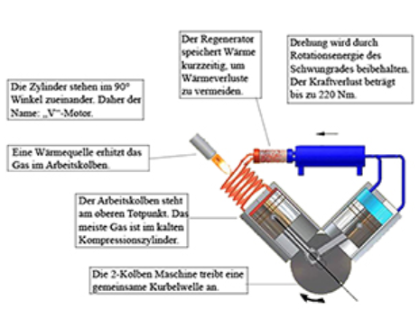
Research
“Spatial Continuity Effect vs. Spatial Contiguity Failure. Revising the Effects of Spatial Proximity Between Related and Unrelated Representations” by Beege, Wirzberger, Nebel, Schneider, Schmidt, and Rey
Spatial proximity does influence learning performance.
Compared high, medium, and low pictorial and text manipulations over two studies
Determined that medium spatial proximity leads to highest retention and transfer scores⁵
Low
Medium
High

Slide 9
Summary
If ever possible it is best to integrate, rather than separate your presentation of a picture and supporting text.⁶
Screen/page space is a limited resource in great demand.
Always aim to decrease cognitive load.

Slide 10
Thank You!
Sources:
1. Marino, M. (2021, February 9). Mayer's Spatial Contiguity Principle. YouTube. https://www.youtube.com/watch?v=xhIDxTXlLis.
2. Mayer, R. E. (2012). Chapter 7: Spatial Contiguity Principle. In Multimedia Learning (Second, pp. 135–152). essay, Cambridge University Press.
3. Creating and adapting content for online delivery. Mayer's 12 Principles of Multimedia Learning: The Spatial Contiguity Principle - Group Related Information. (n.d.). https://www.skillsandparticipation.co.uk/mod/book/view.php?id=11082&amp;chapterid=170#:~:text=The%20Spatial%20Contiguity%20Principle%20is,visuals%20are%20physically%20close%20together.&amp;text=This%20physically%20separates%20the%20text,graphics%20should%20be%20presented%20together.
4. Ingman, J. (2019, October 8). 4. Spatial Contiguity Principle. Faculty Learning Corner. http://flc.learningspaces.alaska.edu/?p=4935.
5. Beege, M., Wirzberger, M., Nebel, S., Schneider, S., Schmidt, N., &amp; Rey, G. D. (2019). Spatial Continuity Effect vs. Spatial Contiguity Failure. Revising the Effects of Spatial Proximity Between Related and Unrelated Representations. Frontiers in Education, 4. https://doi.org/10.3389/feduc.2019.00086
6. Nemesh, A. (2021, May 12). 4 Tips To Combine Text And Graphics For Better eLearning. eLearning Industry. https://elearningindustry.com/4-tips-combine-text-and-graphics-for-better-elearning.

