Slide 1
Learning the Language of Flowers
Alyssa Garcia
EME 602

Slide 2
Learning Objectives
After this lesson, you will be able to:
Recall instances where flowers are used.
Identify different types of flowers and their associated meanings.
Distinguish between different color meanings for specific flowers.
Assemble a bouquet that accurately represents emotions pertaining to a particular event.

Slide 3
Where are flowers commonly seen?

Slide 4
Why?
Special Occasions
Gifts
Celebrations or Condolences
Convey Emotions

Slide 5
Roses
Flowers
Rose
Red Rose:
Love; Respect
Yellow Rose:
Joy; Friendship
Dark Pink Rose:
Thankfulness

Slide 6
Carnations
Flowers
Carnation
Fascination/Divine Love
Red Carnation:
Admiration
Yellow Carnation:
Disappointment; Rejection
Pink Carnation:
“I will never forget you.”

Slide 7
Hyacinth
Flowers
Hyacinth
Games and Sports; Apollo
Purple Hyacinth:
Sorry; Forgiveness
Yellow Hyacinth:
Jealousy
Blue Hyacinth:
Faithful/Dependable

Slide 8
Review
Flowers
Used to Convey Emotions
Rose
Red Rose:
Love; Respect
Yellow Rose:
Joy; Friendship
Dark Pink Rose:
Thankfulness
Hyacinth
Games and Sports; Apollo
Purple Hyacinth:
Sorry; Forgiveness
Yellow Hyacinth:
Jealousy
Blue Hyacinth:
Faithful/Dependable
Carnation
Fascination/Divine Love
Red Carnation:
Admiration
Yellow Carnation:
Disappointment; Rejection
Pink Carnation:
“I will never forget you.”

Slide 9
Assignment
Create a bouquet of flowers for a special occasion of your choice.
For this assignment:
Name the occasion you are making the bouquet for.
Select a minimum of five flowers, (at least three different flowers/colors.)
Explain why you chose each flower and the meaning of the bouquet to your chosen recipient.

Slide 10
Congratulations! You can now speak the language of flowers!

Slide 11
Meaningful Learning Theory
Alyssa Garcia
EME 602

Slide 12
Basic Concepts
What it Isn’t:
Rote memorization is not to be considered meaningful learning
Why?- The learner has made no real connection between what was known and what has been memorized
Learning must be processed in non-arbitrary and substantive ways to be considered meaningful

Slide 13
Characteristics
Meaningful Learning- The occurrence of learners actively interpreting their experiences using certain internal, cognitive operations
Anchoring Ideas-
Ingrained based on previous experiences
Comprise the cognitive structure
Serve as the baseline from which new concepts can ground, or subsume, themselves
Derivative Subsumption- Learning a concept that is derived from an overarching idea
Correlative Subsumption- Modifies and expands the overarching idea itself
Superordinate Learning- Combination of concepts creates an encompassing idea for concepts
Combinatorial Learning- Combines similar ideas for a broader understanding of an established concept
Notes:
What happens when learners use prior knowledge and experience as a lens to learn more about a given concept.
Superordinate - An example of this type of learning is when a person “learns their lesson” after a series of events

Slide 14
Assimilation with Schema Theory
Schema- An “organizing and orienting attitude that involves active organization of past experiences”; Conceptual
Suggests learning can be predicted based upon a learner’s past experiences and preestablished schemata
Modification of schema occurs in three ways:
Accretion- Remembering a fact that was not initially vital to the understanding of the overall concept
Tuning- Learner uses prior knowledge in a new context
Restructuring- Modifying or creating a new schema due to being exposed to new information
Notes:
Schema Theory is assimilated to Meaningful Learning as they share some common ideas.
Schema- This is like the anchoring ideas of meaningful learning, but schemata are conceptual while anchoring ideas are cognitive.

Slide 15
Assumptions about Learners
Learners must:
have a relevant, stable, and organized cognitive structure
actively use the cognitive structure to gain meaningful connections from what they learn
Predetermined Challenges:
Age-
Adults = Abstract and complex
Children = Concrete; Much less experience
Cultural Diversity-
Experience levels
Engaging with more than one learner at a time from a variety of backgrounds
Retention-
“Gist”
Cognitive Load Limitations
Notes:
This is not to say that students with unstable cognitive structures are unable to have meaningful learning moments, but they must be assisted by being provided appropriate materials that aid the connections to be made. “meeting the learner where they are”
, storing many ideas is cumbersome and learners often only manage to retain a fraction, or gist, of the information presented

Slide 16
Suggested Instructional Principles
The learning task must be set as meaningful, materials must be potentially meaningful, and that prior knowledge is available and relates to what will be learned
All principles must be met for meaningful learning to occur
Cannot be memorization-based: must be relevant to the student, and student must have a knowledge base to draw from
Ausubel’s Most Important Principle:
“Ascertain the cognitive structures of your learners and teach accordingly…”
Notes:
Set as conditions
Meeting learners where they are is very important because knowing any given person’s full array of experiences and prior knowledge is not gained at a glance. A person’s prior knowledge and perception of meaning on a topic can influence the way the information is structured in their cognition. By finding out how a learner relates to the material, the instructor can more easily facilitate meaningful learning.

Slide 17
View From Other Theories
Limited to Transfer
Not focused on how people learn when to use knowledge
Most robust when combined, not substantiated enough without Schema Theory
Notes:
How information and knowledge affects new information

Slide 18
Meaningful Learning vs Gagné
Meaningful Learning Theory
Meaning matters most
Reliant on existing cognitive structure
“Conditions” of instruction
Conditions met by instruction for learning to occur
Gagné’s Instructional Theory
Specific learning outcomes
Ordered process for learning
“Events” of instruction
Conditions met by students for learning to occur

Slide 19
Meaningful Learning vs CIP
Meaningful Learning Theory
Reliant on preexisting cognitive structure or schemata
Learning is guided by instructor
Conditions met by instruction for learning to occur
Cognitive Information Processing
Learners process information in relation to established memory
Students monitor their own learning
Instruction intended to organize information, direct attention, and enhance encoding and retrieval

Slide 20
Why Meaningful Learning?
Several other theories reference learning needing to be meaningful
Ex. ARCS - Relevancy
Meets learners where they are; Just-in-Time Learning
“Sticks” because it has an emotional/meaningful connection to the learner

Slide 21
Best Way to Assess
Comparative organizers and elaboration
Thought demanding activity
Skillful use of mental models
Provide new contexts and examples to apply prior knowledge to

Slide 22
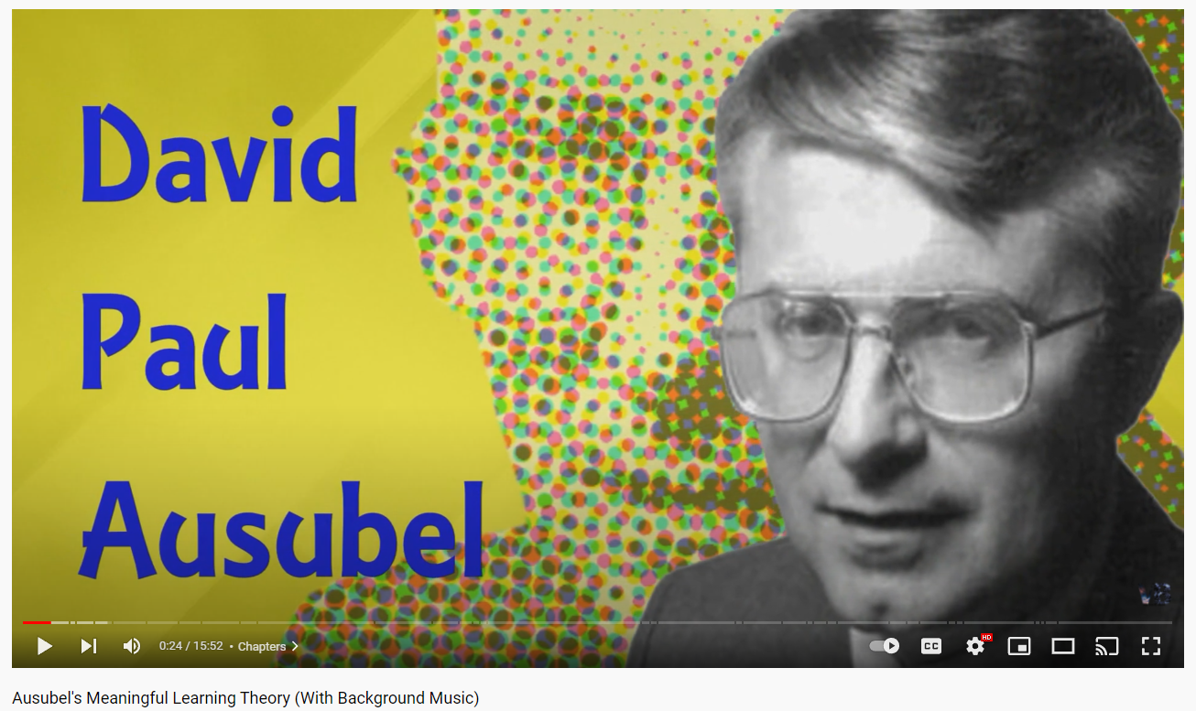
Video Resource

Slide 23
Sources
Driscoll, M. P. (2014). Psychology of learning for instruction (3rd ed.). (pp. 115-122, 125-127, 129-130, 135-137). Boston, MA: Pearson.
The language of flowers with their meaning. (2004, December 1). The language of flowers. Retrieved November 14, 2021, from http://thelanguageofflowers.com/

